Slide 1
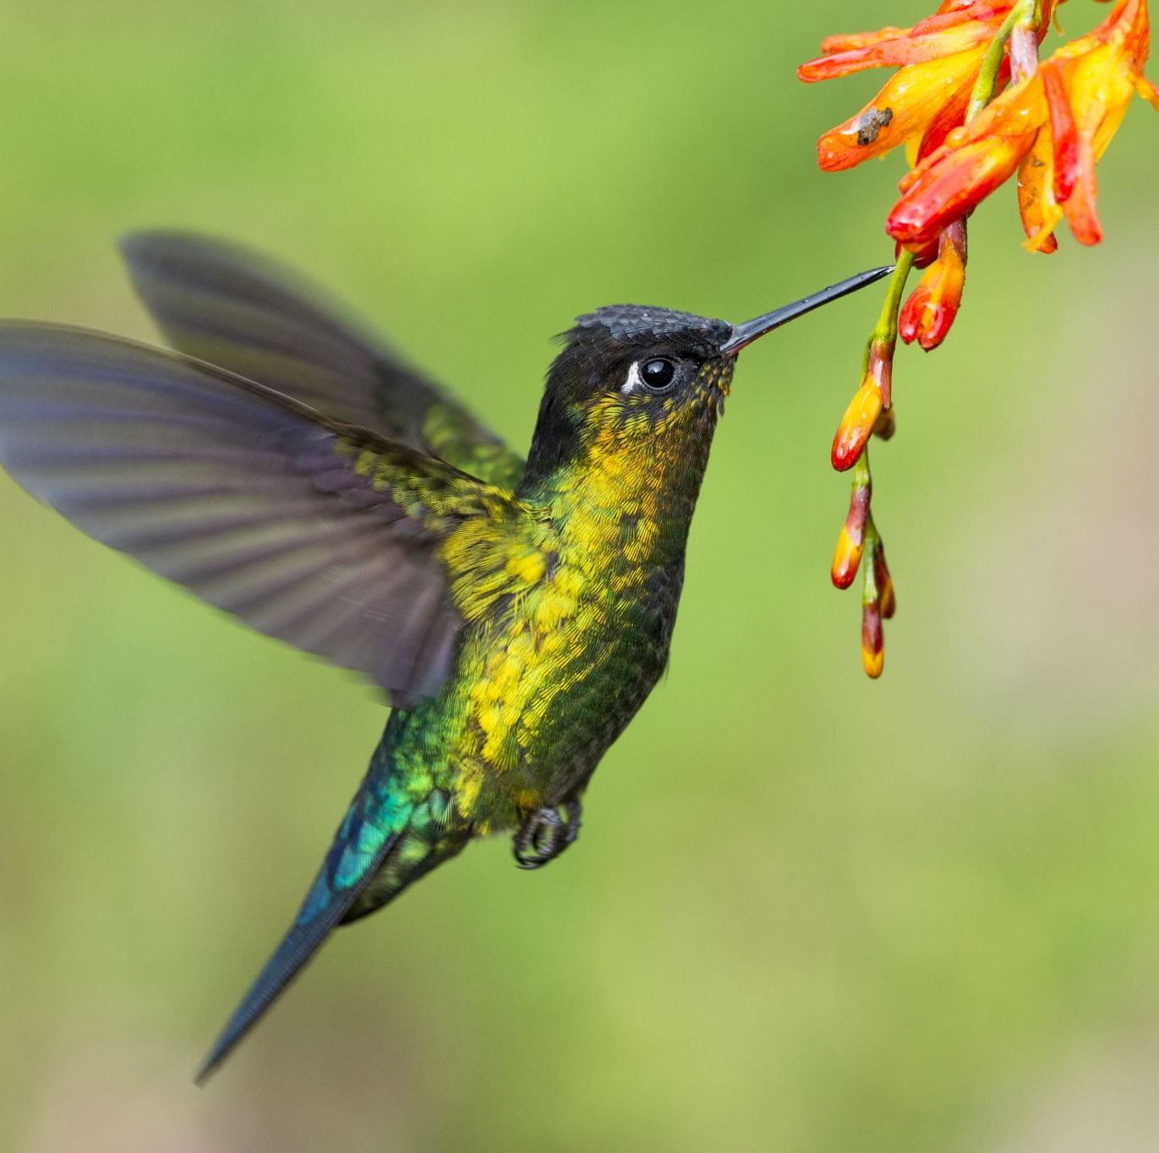
Classification of Bird Species
By Pizon Shetu

Slide 2
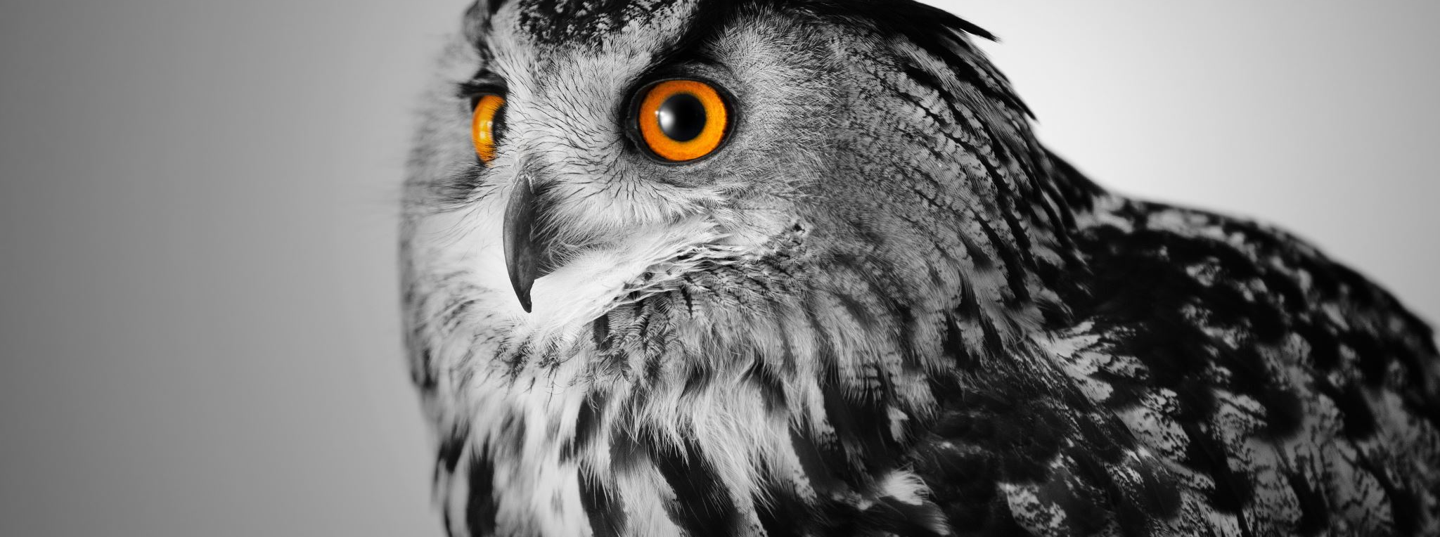
Problem Statement
Numan Bird Watch needs a robust model which can identify and classify various species of birds
Model must be able to be trained on new data

Slide 3
Predicting Birds using Machine Learning
How can machine learning help predict different species of birds?
Neural Networks

Slide 4
Dataset
Data set consist of 45980 training, 1575 validating, and 1575 testing images
Each image is 224X224X3 in JPG
Data is clean with no anomalies and duplicates
Data set consist of 315 different species of birds

Slide 5
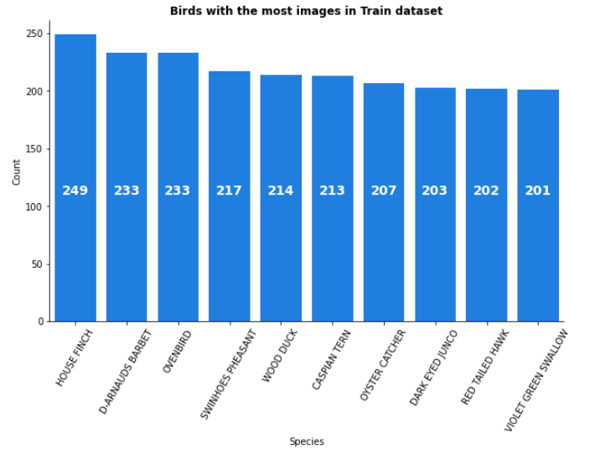
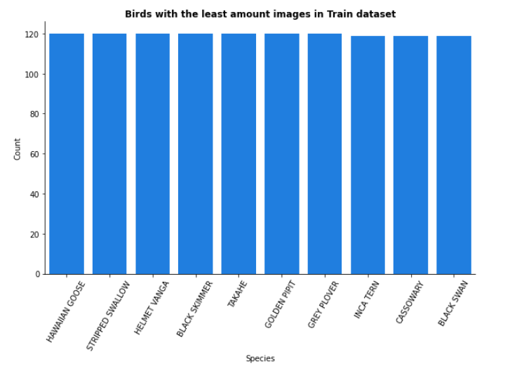
Distribution of birds
Testing and validating set has equal number of images per bird species which is 5
Minimum number of images for any given specie is 120

Slide 6
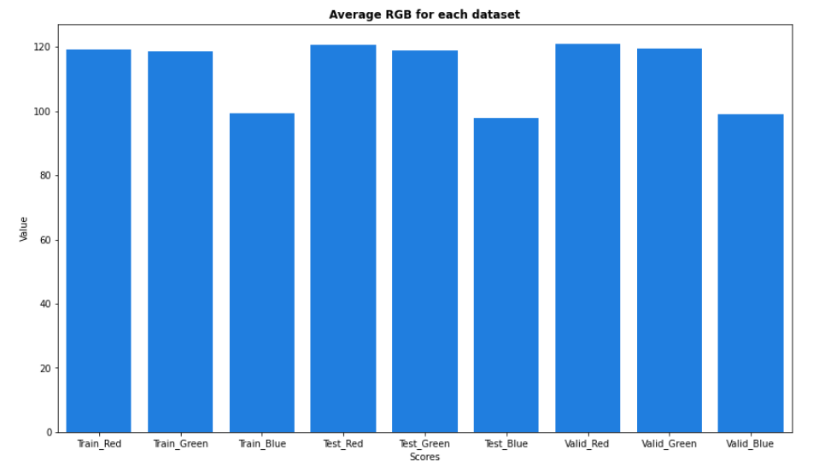
RGB Distribution

Slide 7
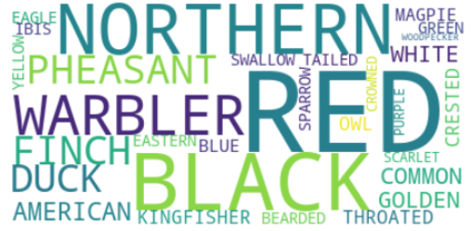
Word Cloud

Slide 8
Preprocessing
Rescaling data from 224x224 to 56x56
01
Normalizing data to have a mean of 0
02

Slide 9
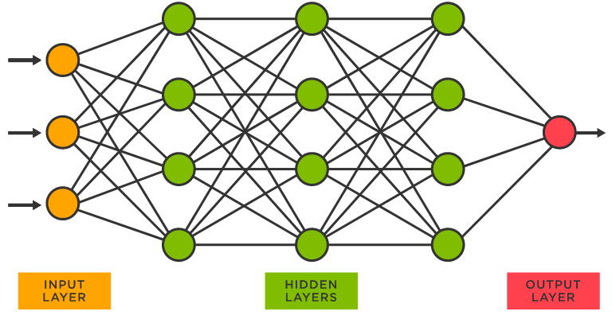
Neural Networks

Slide 10
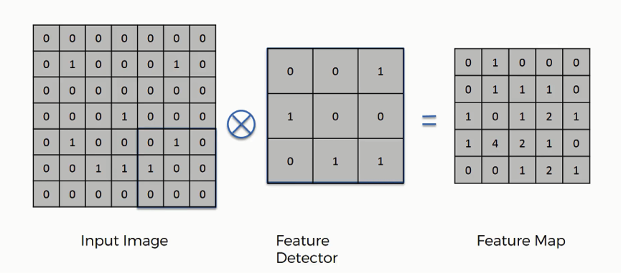
Convolutional Neural Network
This Photo by Unknown Author is licensed under CC BY-NC

Slide 11
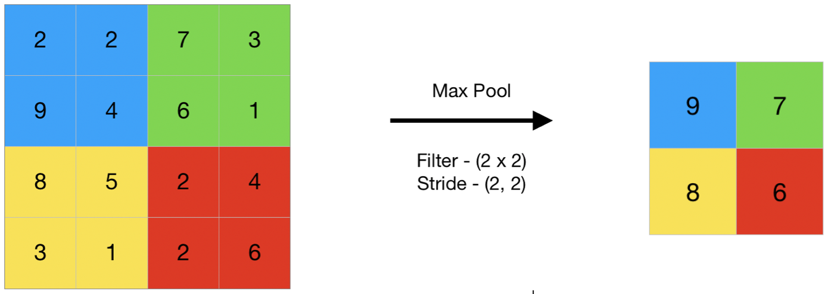
Max Pooling
Allows for less computation needed for training
Highlights the most important features

Slide 12

Fully Connected CNN

Slide 13
Sequential Model
Sequential Model allows to create models layer by layer
Conv2D
Filters
Kernel Size
Strides

Slide 14
Sequential Model
MaxPool2D
Flatten
Dense
Dropout
Optimizer
Loss
Metric
Epoch

Slide 15
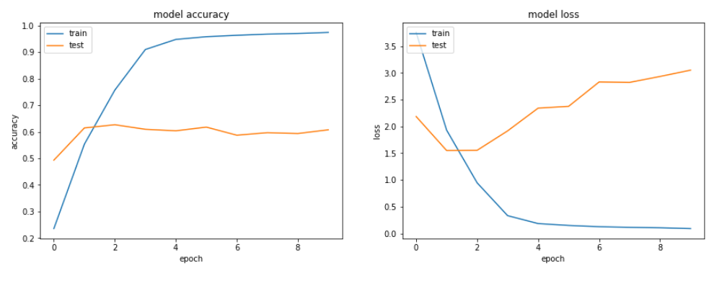
Basic Model
60% Accuracy rate

Slide 16
Hyperparameter Tuning
RandomSearch
Hyperband
Bayesian Optimization

Slide 17
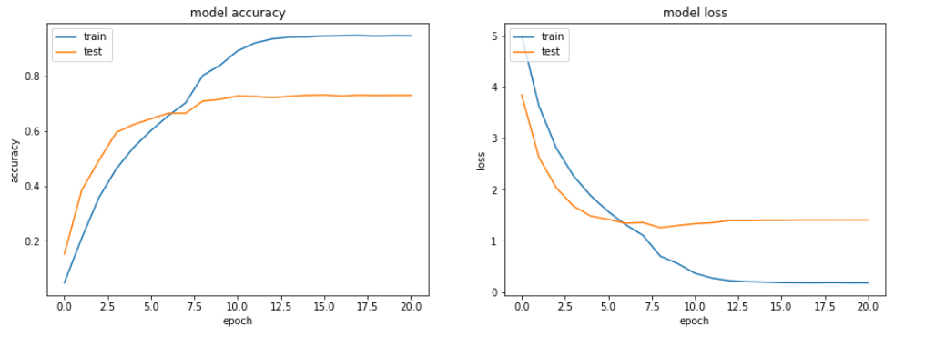
Best Model without Transfer Learning
After Tuning achieved 73.2% accuracy score

Slide 18

Transfer Learning
Transfer learning is using past models knowledge to increase the learningcapabilities of new models. Pre-Trained models are models created by someoneor others to solve a similar problem but rather than building a model fromscratch you utilize and tweak their already built model to your own problem.

Slide 19
Freezing/Unfreezing Layers
Save time training models
Avoid re-learning early steps like detecting edges and lines

Slide 20
Pre-trained Models
EfficientNet - a CNN architecture where the scaling method uniformly scalesthe dimensions of depth, width and resolution using a compound coefficient
VGG16 - invented by the Visual Gemoetry Group of Oxford University andproposed by Karen Simonyan and Andrew Zisserman, it was used to win 1stplace at 2014 ILSVRC callenge

Slide 21
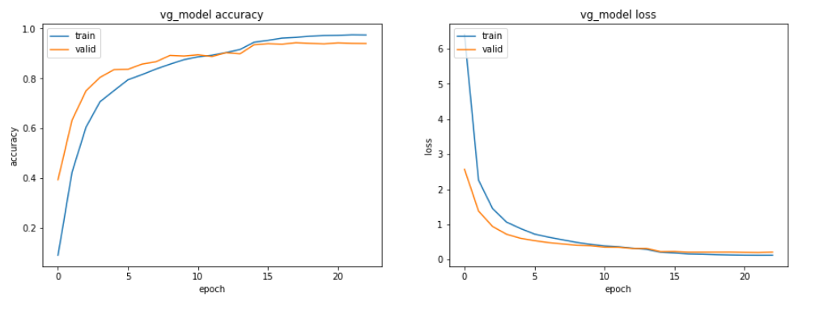
VGG16 Model
A key distinction with VGG16 is rather than have large number of hyper-parameters they instead focused on having many convolution layers of 3v3 filters and always used same padding with a maxpool layer of 2x2.
Has approximately 138 million parameters.
Able to get 94% accuracy score after 23 epochs

Slide 22
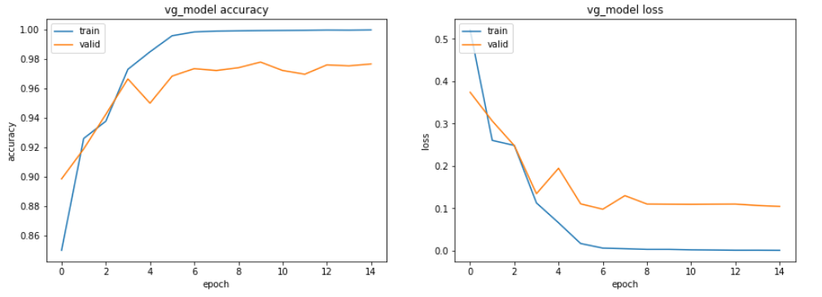
Tuning VGG16
Freezing lower layers
97.5% accuracy on unseen data

Slide 23
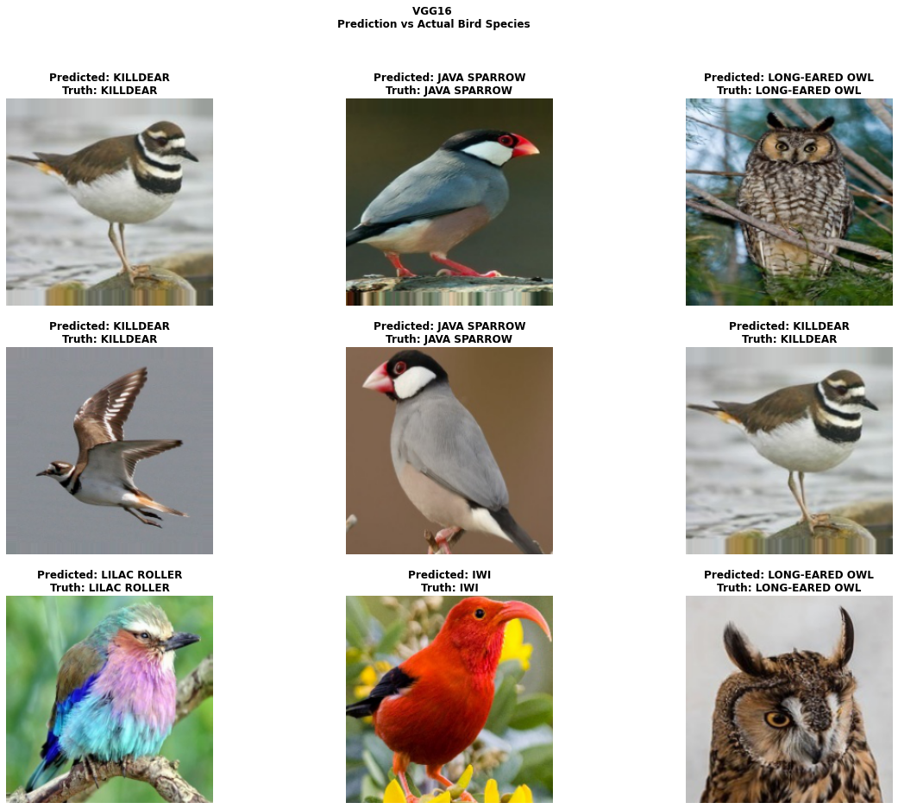
Predictions

Slide 24
Takeaways
Achieved 97.5% accuracy
Can distinguish even almost identical looking birds but are different species
Can be easily trained on new data
CNN is a challenging topic when diving into the math
Future work, object and facial recognition

